Slide 1
Channel Access
Kay Kasemir based on material by
Bob Dalesio (then LANL)
Ned Arnold (APS)
Ken Evans (APS)
July 2026
Feb. 2022

Slide 2

Channel Access: The EPICS Network Protocol
Read and write Process Variables over the network.
To many, CA is EPICS.
  Especially if your background is w/ systems
  that have no IOC database.
  "Integrate into EPICS" really means:
  Talk CA on the network.
Channel Access

Slide 3
Advantages over similar Control System/IoT Protocols
”Zero config” for small setups, yet scales to large networks
Distributed, no central “Name Server” or “Broker” bottleneck
Read/write/subscribe (‘get’, ‘put’, ‘monitor’)
  Monitor sends initial value
  ‘put-callback’ option for assured completion
Data types that combine value with timestamp, units, status
To end user:
Look at operator display and enjoy what you see
Maybe use channel name to create your own displays, scripts, …

Slide 4
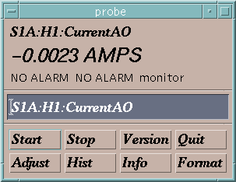
Channel Access in One Slide
“connection request” or “search request”
“get” or
“caGet”
“put” or
“caPut”
“set a monitor”, “subscribe”
Who has a PV named “S1A:H1:CurrentAO”?
Change its value to 30.5
Notify me when the value changes
What is its value?
Channel Access Client
CA Client
CA Server
Channel Access Server
I do.
25.5 AMPS
OK, it is now 30.5
It is now 20.5 AMPS
It is now 10.5 AMPS
It is now -0.0023 AMPS
Process Variables:
S1A:H1:CurrentAO
S1:P1:x
S1:P1:y
S1:G1:vacuum
“put complete”
“post an event”,
“post a monitor”,
“publish an update”
30.5 is too high. It is now set to the maximum value of 27.5.
or
You are not authorized to change this value
or

Slide 5
Reading and Writing
'caget' command-line tool to read:
  > caget epics-dev:tank
  epics-dev:tank 30.5382
  > caget epics-dev:tank.DESC
  epics-dev:tank.DESC Tank Temperature or INVALID
'caput’ to write:
  > caput epics-dev:tank.DESC "Tank temperature"
  Old : epics-dev:tank.DESC Tank Temperature or INVALID
  New : epics-dev:tank.DESC Tank temperature
Examples use /ics/examples/fishtank

Slide 6
Data types
'cainfo’ to determine data type:
  > cainfo epics-dev:tank
  … Native data type: DBF_DOUBLE …
  > cainfo epics-dev:tank.DESC
  … Native data type: DBF_STRING …
  > cainfo epics-dev:tank.SCAN
  … Native data type: DBF_ENUM …
DBF_... DataBase Field

Slide 7
Data types…
'caget –d …’ to fetch specific data type:
  > caget -h
  Usage: caget [options] <PV name> …
  -d <type>: Request specific dbr type …(DBR_ prefix may be omitted)
  …
  > caget –d DOUBLE epics-dev:tank Just the value
  > caget –d STS_DOUBLE epics-dev:tank
  > caget –d TIME_DOUBLE epics-dev:tank Control system essentials
  > caget –d GR_DOUBLE epics-dev:tank
  > caget –d CTRL_DOUBLE epics-dev:tank Everything .. except the time??
  > caget –d STRING epics-dev:tank.SCAN Enum combines a label with a number
  > caget –d SHORT epics-dev:tank.SCAN
  > caget –d CTRL_ENUM epics-dev:tank.SCAN
DBR_... DataBase Request

Slide 8
'camonitor'
'camonitor' monitors value changes:
  > ﻿$ camonitor epics-dev:tank
  ﻿epics-dev:tank 2026-05-14 11:59:23.407152 68.6682
  epics-dev:tank 2026-05-14 11:59:23.907023 69.2315
  epics-dev:tank 2026-05-14 11:59:24.407060 69.7892
  epics-dev:tank 2026-05-14 11:59:24.906853 70.3413 HIGH MINOR
  epics-dev:tank 2026-05-14 11:59:25.406717 70.8879 HIGH MINOR
  … plus one more each second…
  … press Ctrl-C to stop …
  > ﻿camonitor epics-dev:tank.DESC
  epics-dev:tank.DESC 2026-05-14 11:20:40.311549 Tank temp
  … and then nothing …
A.k.a. subscribe.
Channel Access supports monitoring
DBR_DOUBLE,
DBR_TIME_DOUBLE,
DBR_CTRL_DOUBLE, …
but ‘camonitor’ always uses DBR_TIME_...

Slide 9
When will ‘camonitor’ receive new value?
When the CA server (IOC) sends a new value!
  Binary records: Every change
  Analog records: VAL change beyond
  MDEL (monitor delta) or
  ADEL (archive delta)
Client subscription options
  DBE_VALUE
    Value changed beyond MDEL
  DBE_LOG
    Meant for archive systems, … ADEL
  DBE_ALARM
    Alarm status/severity changed
  DBE_PROPERTY
    DBR_CTRL_... units, limits, … changed
﻿$ camonitor -h
…
-m <msk>: Specify CA event mask to use.
<msk> is any combination of
'v' (value), 'a' (alarm),
'l' (log/archive), 'p' (property).
Default event mask is 'va'
Well behaved, generic clients
Determine the native type
Get DBR_CTRL_type once
or monitor with DBE_PROPERTY
Monitor DBR_TIME_type with DBE_ALARM and either .._VALUE or .._LOG
Complete information
while minimizing network traffic,

Slide 10
How do Clients find Channels?
.. and what happens then?

Slide 11
Internet 101
User Datagram Protocol (UDP)
  Sends a network packet
    from one port on one computer
    to one or more ports on one or more other computers.
    ..with one or more listeners on the target ports
  Fast!
  Checksum: If the packet arrives, it's OK.
  Not reliable: Packets get lost, arrive out-of-order, arrive more than once.
Transmission Control Protocol (TCP)
  Sends a stream of bytes from one port on one computer to another port on another computer, with exactly one listener on the target port
  Reliable: Bytes arrive at the receiver in the correct order.
    Basically, adds sequence numbers to UDP packets,
    requesting repeats for missing packages.
  Slower, and message boundaries get lost:
    "Hello Fred!" might arrive as "Hel" <pause> "lo F" <pause> "red!"

Slide 12
Search and Connect Procedure
Client
Client
Client
Client
Client
Client
3. TCP Connection
Let’s talk !
2. UDP Reply
I have it !
UDP Broadcast Sequence
Who has it ?
Server
IOC
IOC
Check
Check
IOC
IOC
Check
Check
Meter
Power Supply
Camera

Slide 13
Search Request
A search request consists of a sequence of UDP packets
  Per default: Broadcast to the local subnet.
    Basically plug-and-play when you get started.
  Or to IP addresses listed in EPICS_CA_ADDR_LIST
    Most routers don’t forward broadcasts!
    You must add 'other' subnets or specific IOCs off the local subnet to that environment variable!
  Starts with a small interval (0.1 s)
    Doubles each time, until reaching 5 minute intervals.
    Stops when it gets a response
    Wakes again on "beacon anomaly" (details follow later)
CA Servers check each search packet
Usually connects on the first packet or the first few
  But non-existent PVs waste network bandwidth
  Try to eliminate them!
Searches
Time

Slide 14
Important Environment Variables
EPICS_CA_ADDR_LIST
  Determines where to search
  Is a list (separated by spaces)
    “123.45.1.255 123.45.2.14 123.45.2.108”
  Default is broadcast addresses of all interfaces on the host
    Works when servers are on same subnet as Clients
  Broadcast address
    Goes to all servers on a subnet
    Example: 123.45.1.255
    Use `ifconfig –a` or `ip address` to find it on Linux
EPICS_CA_AUTO_ADDR_LIST
  YES: Include default addresses in searches
  NO: Do not search on default addresses, only use EPICA_CA_ADDR_LIST
  If you set EPICS_CA_ADDR_LIST, usually set this to NO

Slide 15
EPICS_CA_ADDR_LIST
EDM
CSS
Client
Client
Client
python
Broadcast
123.45.1.255
Specific
123.45.2.2
Not Included
CA Server
123.45.1.1
IOC
123.45.1.2
IOC
123.45.2.1
IOC
123.45.2.2
Subnet
123.45.1.x
Subnet
123.45.2.x

Slide 16
Multiple “softIoc” on same Host
Host, IP 1.1.1.1
IOC
TCP 5064
IOC
TCP ???
IOCs on IP 1.1.1.1, net 1.1.1.0
  UDP 5064, TCP 5064
  UDP 5064, TCP ???
Try to reach from other subnet
  EPICS_CA_ADDR_LIST=1.1.1.1
    Won’t work!
    Quirk in network kernels:
    Only the IOC started LAST (FIRST on Windows)
    will get anything on UDP 5064
  EPICS_CA_ADDR_LIST=1.1.1.255
    OK. When using broadcast into subnet, all IOCs on UDP 5064 will see search requests.
UDP 5064
1.1.1.255
Outside client

Slide 17
Firewall?!
Host, IP 1.1.1.1
IOCs on IP 1.1.1.1, subnet 1.1.1.0
  UDP 5064, TCP 5064
  UDP 5064, TCP ???
  EPICS_CA_ADDR_LIST=1.1.1.255
Firewall cannot open unpredictable TCP ???
Likely to block broadcasts
Need to run CA Gateway:
  Firewall allows access to CAGateway
  CAGateway uses broadcast inside subnet
IOC
TCP 5064
IOC
TCP ???
Firewall:
Open UDP 5064,
TCP 5064 and ??
Outside client

Slide 18

Handling of Network Interruptions
No Network is up 100%, so CA was designed to handle this:
  TCP connection closed by server?
    Notify client code about problem
      Operator displays tend to indicate this.
    Client sends new search requests.
  No data nor beacon from server for 30 sec.?
    Client sends “Are you there?” query
    If no response for 5 sec, also notify client code, but TCP connection is kept open to avoid network storms.
    If server eventually sends data: OK. Otherwise, we're waiting until the OS cuts the TCP connection (minutes to hours).

Slide 19
Beacons
Assume all is fine, we are connected, but the data simply doesn't change.
  How do we know the server is still OK?
Assume we searched for a PV, didn't get any response for ~8 minutes.
  How do we learn about a new CA server starting up which might have the missing PV? What triggers renewed search requests?

Slide 20
Beacons!
UDP broadcast packet sent by a CA Server
When it is healthy, each Server broadcasts a UDP beacon at regular intervals (like a heartbeat)
  EPICS_CA_BEACON_PERIOD, 15 s by default
When it is coming up, each Server broadcasts a startup sequence of UDP beacons
  Starts with a small interval (~2 ms)
  Interval doubles each time until reaching 15 sec
Clients monitor the beacons
  Receive beacons: Server is OK.
  Receive new beacons at changing intervals: Beacon “anomaly”, new CA server, restart searches.

Slide 21

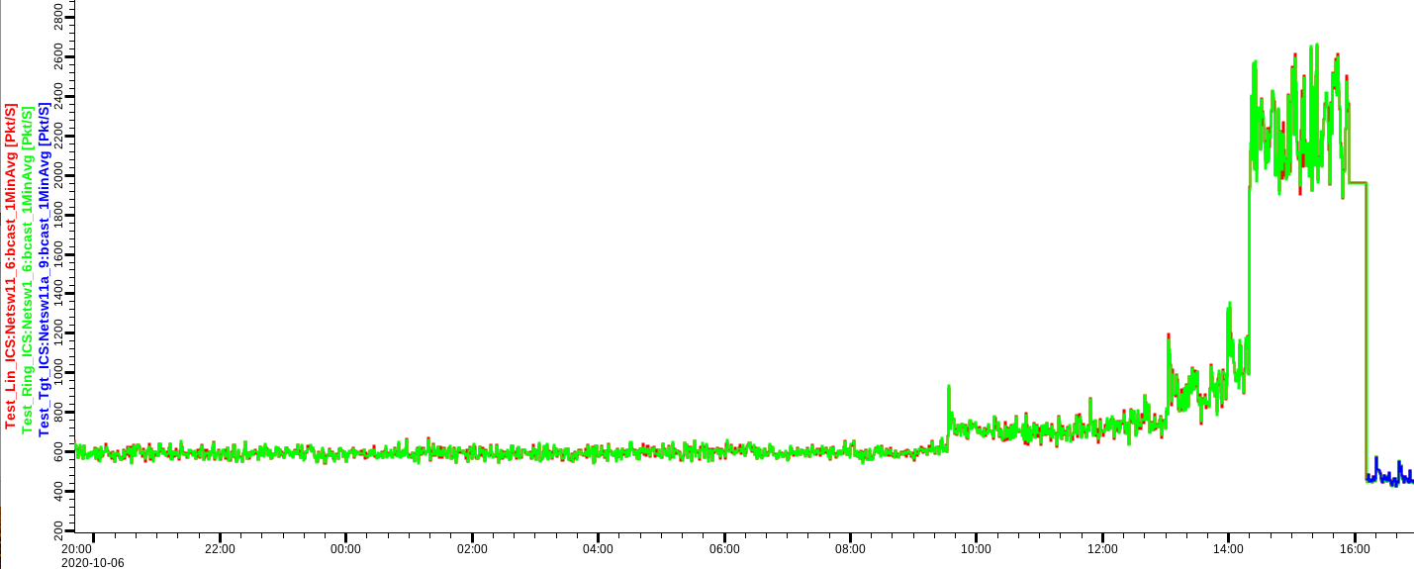
Beacon: Seemed like a good idea, but…
Archive setups may have many missing PVs
Overloaded IOCs or network delays may change beacon pattern
.. into this:
➔ Clients with disconnected channels re-start their searches!
Burst in network traffic

Slide 22
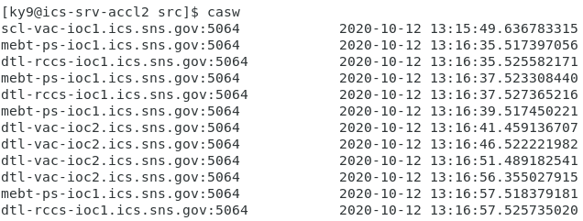
Monitor & Maintain CA Network
Check clients for disconnected channels
  Archive
  Displays
  Run “caSnooper” to spot such clients
Periodically run “casw”
  Lists “beacon anomalies”
  Are those CA servers indeed “new”?

Slide 23
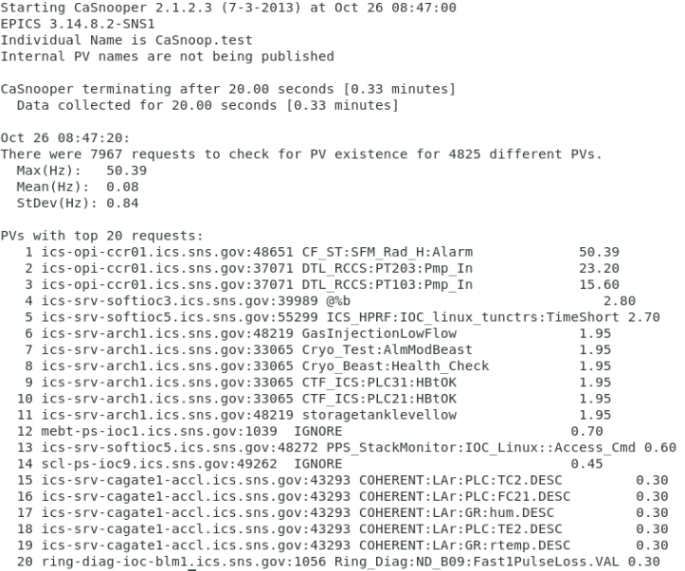
caSnooper
Example caSnooper –p20 –t20

Slide 24
caRepeater?
Older OSs didn't allow multiple programs to listen to the same UDP port
  They didn't see the beacons (UDP broadcasts)!
caRepeater solves this problem
  There is one caRepeater process per workstation
  Clients make a TCP connection to it when they start up
  caRepeater receives the beacons
    EPICS_CA_REPEATER_PORT[usually 5065]
  .. and forwards them to clients.
IOC1
Client Computer
Client
IOC2
CaRepeater
Client
IOC3
…

Slide 25
Issues
CA Client does not connect
  Check basic network connectivity.
    Can server and client machines 'ping' each other?
    Check EPICS_CA_ADDR_LIST. Is server on different subnet?
CA Client re-connects slowly after network issue or IOC reboot
  Use casw, wireshark: Does the client computer receive the (anomal) beacons of the rebooting IOC?
  Check EPICS_CAS_BEACON_ADDR_LIST,since routers will not forward beacons across subnets.
  Check if 'caRepeater' is running on the client.

Slide 26
Points to remember
In 99% of the cases, CA "just works"
If not, check EPICS_CA_ADDR_LIST
If that's not it, there could be a subnet/router issue with UDP search broadcasts and beacons.

Slide 27
Comparison to PV Access
Same basic idea: UDP searches, then TCP to get/put/monitor
EPICS_PVA_ADDR_LIST instead of EPICS_CA_ADDR_LIST
No caRepeater necessary
More data types
  “Normative types” for all the DBR_.. Info
  Plus “Image”, “Table”, and optional custom types
Supports IPv6
“Secure PVA” development: Authentication, encryption

